Slide 1
Digital Signature, its properties, requirements and security
Name: Dhruven Vaghela
En. No: 170210107060
Subject: INS
Branch: 7th sem, CE

Slide 2
Digital Signature
Message authentication does not address issues of lack of trust
Digital signatures provide the ability to:
verify author, date & time of signature
authenticate message contents
be verified by third parties to resolve disputes
DS includes message authentication function with additional capabilities

Slide 3
Properties
Must depend on the message signed
Must use information unique to sender
to prevent both forgery and denial
Must be relatively easy to produce
Must be relatively easy to recognize & verify
Be computationally infeasible to forge
with new message for existing digital signature
with fraudulent digital signature for given message
Be practical to save digital signature in storage

Slide 4
Requirements
Private Key
The private key is one which is accessible only to the signer. It is used to generate the digital signature which is then attached to the message.
Public Key
The public key is made available to all those who receive the signed messages from the sender. It is used for verification of the received message.
Digital Signature Certificate
A subscriber of the private key and public key pair makes the public key available to all those who are intended to receive the signed messages from the subscriber.
But in case of any dispute between the two sides, there must be some entity with receiver which will allow the receiver of the message to prove that the message was sent by the subscriber of the key pair. This can be done with the Digital Signature Certificate.

Slide 5
Attacks
Attacks on digital signature
1.) Attack Types
2.) Forgery Types
1.) Attack Types
Key-Only Attack
The attacker is only given the public verification key.
Known-Message Attack
The attacker is given valid signatures for a variety of messages known by the attacker but not chosen by the attacker.
Chosen-Message Attack
The attacker first learns signatures on arbitrary messages of the attacker’s choice.

Slide 6
2.) Forgery Types
Existential Forgery
Existential forgery is the creation of any message/signature pair(m,σ), where σ was not produced by the legitimate signer.
Selective Forgery
Selective forgery is the creation of a message/signature pair(m,σ) where m has been chosen by the adversary prior to the attack.

Slide 7
Security
1.) Message Authentication
2.) Message Integrity
3.) Nonrepudiation
4.) Confidentiality
1.) Message Authentication
A secure digital signature scheme, like asecure conventional signature can provide message authentication.
2.) Message Integrity
The integrity of message is preserved even if we sign the whole message because we cannot get the same signature if the message is changed.

Slide 8
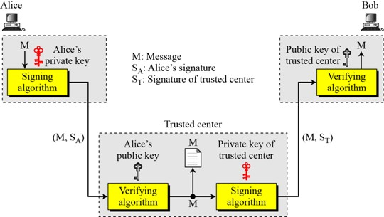
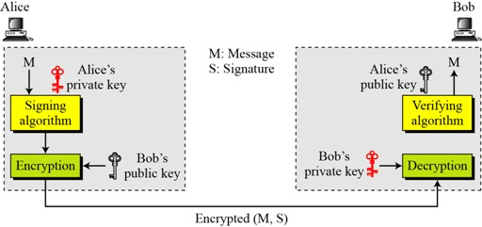
3.) Nonrepudiation
4.) Confidentiality

Slide 9
References:
Reference book of william stallings
slideplayer.com
THANK YOU

